Slide 1

DEPARTMENT OF ARTIFICIAL INTELLIGENCE AND DATA SCIENCE
SCHOOL OF COMPUTING
10214AD701- MAJOR PROJECT
SUMMER SEMESTER 2025-2026
“Transfer Learning for Waste Classification and Reinforcement Learning for Sustainable Resource Optimization”
SUPERVISED BY
Dr.N. Krishnammal,
Assistant Professor, AI & DS Dept
PRESENTED BY
1. J. Navadeep (VTU23403)(REG.NO 22UEAD0040)
2. B. Sai Sumanth (VTU23598)(REG.NO 22UEAD0004)
BATCH NO: 16 : DEPARTMENT OF ARTIFICIAL INTELLIGENCE AND DATA SCIENCE

Slide 2
AGENDA
Introduction/Overview
Background/Literature Review, Gap Analysis
Objectives
Proposed Flowchart/Methodology
Expected Output
Challenges and Mitigation Strategies
Conclusion and Future Work
BATCH NO: 16 : DEPARTMENT OF ARTIFICIAL INTELLIGENCE AND DATA SCIENCE

Slide 3
Introduction/Overview
Problem Statement:
Urban waste management continues to be a pressing challenge, with growing populations generating increasingly diverse and complex waste streams. Traditional systems often rely on manual sorting, static routing, and reactive resource allocation—leading to inefficiencies, increased landfill dependency, and missed opportunities for recycling. Moreover, the lack of intelligent automation and predictive capabilities limits the scalability and sustainability of current approaches.
Project Goal:
This project aims to design and implement a smart waste management system that leverages Transfer Learning for accurate waste classification and Reinforcement Learning for dynamic resource optimization by integrating real-time data, adaptive decision-making, and predictive analytics
Brief Overview:
A Waste Classification Engine powered by a fine-tuned ResNet50 model using transfer learning, capable of identifying waste types with high precision.
A Resource Optimization Agent based on reinforcement learning, which learns optimal routing and bin allocation strategies to minimize environmental impact and maximize efficiency.
BATCH NO: 16 : DEPARTMENT OF ARTIFICIAL INTELLIGENCE AND DATA SCIENCE

Slide 4
Background/Literature Review
Existing Solutions/Related Work:
Current waste management systems often rely on rule-based sorting mechanisms, static bin allocation strategies, or basic image classifiers. While some use traditional machine learning models for waste categorization, they typically lack adaptability and struggle with real-world variability.
Limitations of Existing Solutions:
These approaches tend to fall short in terms of classification accuracy, real-time decision-making, and environmental impact optimization. Most systems do not incorporate transfer learning, which limits their ability to generalize across diverse waste types..
How Your Project Differs/Improves:
Our project introduces a dual-intelligence framework that combines Transfer Learning for high-precision waste classification and Reinforcement Learning for adaptive resource optimization. By leveraging pre-trained models like ResNet50 and training RL agents on real-world scenarios, the system not only identifies waste accurately but also learns optimal routing and bin allocation strategies.
BATCH NO: 16 : DEPARTMENT OF ARTIFICIAL INTELLIGENCE AND DATA SCIENCE

Slide 5
– Gather and preprocess waste-related data from sensors and image inputs for downstream analysis.
Objectives
Proposed Objectives
Objective 1: Data Collection & Ingestion
– Gather and preprocess waste-related data from sensors and image inputs for downstream analysis.
Objective 2: Waste Classification (Using Transfer Learning)
– Accurately categorize waste types using a fine-tuned ResNet50 model for scalable classification.
Objective 3: Predictive Analytics
– Forecast waste generation trends using time-series models to enable proactive resource planning.
Objective 4: Reinforcement Learning for Optimization
– Train an RL agent to dynamically allocate resources and optimize waste routing strategies.
Objective 5: Sustainability Dashboard & Reporting
– Visualize system outputs and impact metrics in real time through an interactive dashboard for stakeholders.
BATCH NO : DEPARTMENT OF ARTIFICIAL INTELLIGENCE AND DATA SCIENCE

Slide 6
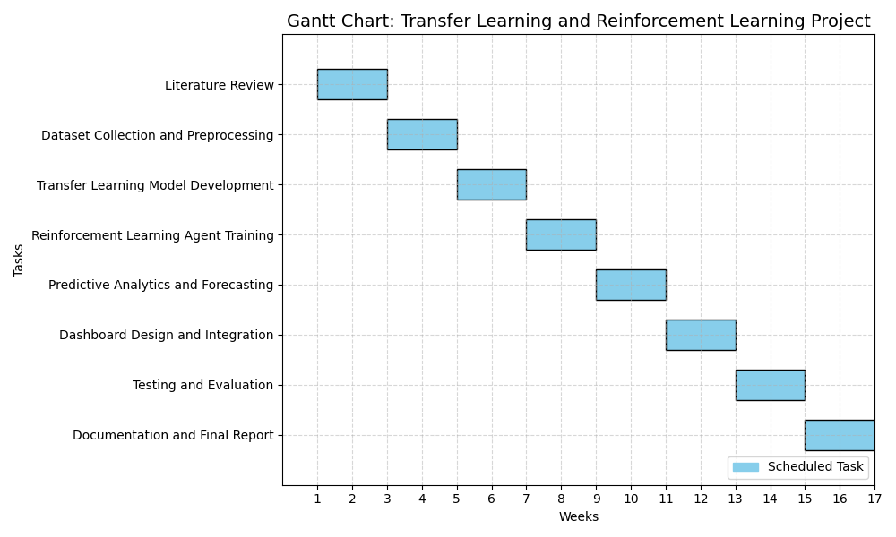
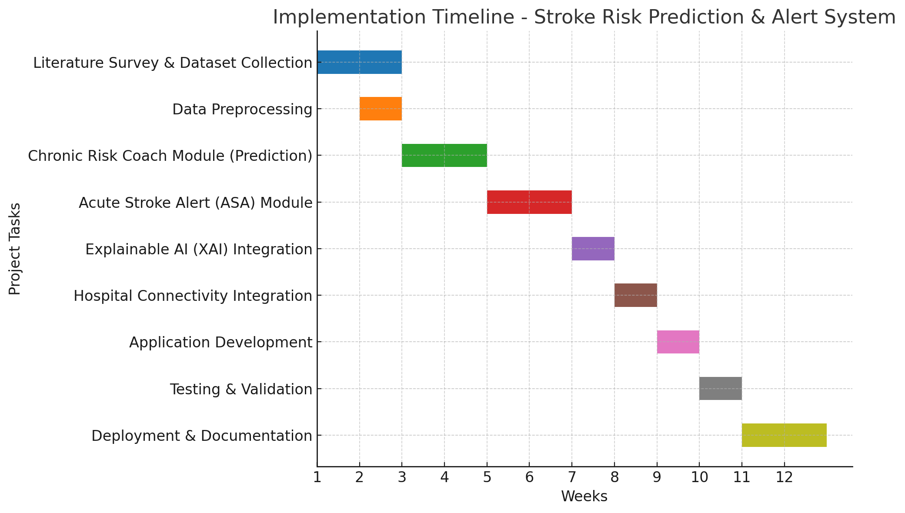
Timeline/Gantt Chart
BATCH NO: 16 : DEPARTMENT OF COMPUTER SCIENCE & ENGINEERING

Slide 7
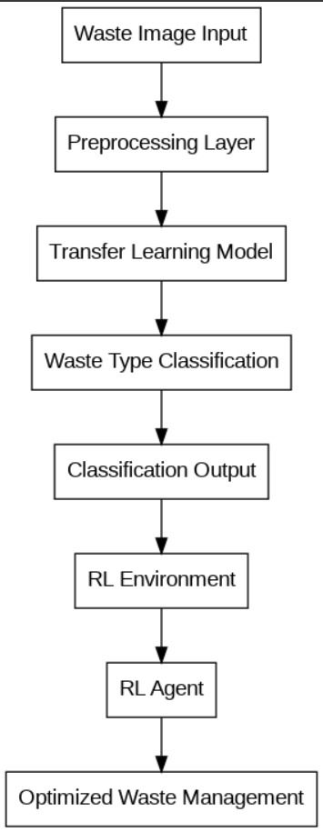
Proposed Flowchart/ Methodology
The proposed system follows a modular and intelligent pipeline designed to automate and optimize waste management using AI. It begins with the Waste Image Input, where raw images are captured from smart bins or user uploads.
Next, a Transfer Learning Model—specifically a fine-tuned ResNet50—is used to perform Waste Type Classification, identifying categories such as plastic, organic, paper, metal, and glass. The Classification Output is then stored in a centralized database and simultaneously fed into a Reinforcement Learning (RL) Environment
The System Architecture Diagram complements this flow by showing how each module interacts—from the User Interface and Image Upload Module, through the Waste Classification Core, to the RL Simulation Engine and Decision Output Module.
Figure 1.
BATCH NO : DEPARTMENT OF ARTIFICIAL INTELLIGENCE AND DATA SCIENCE

Slide 8
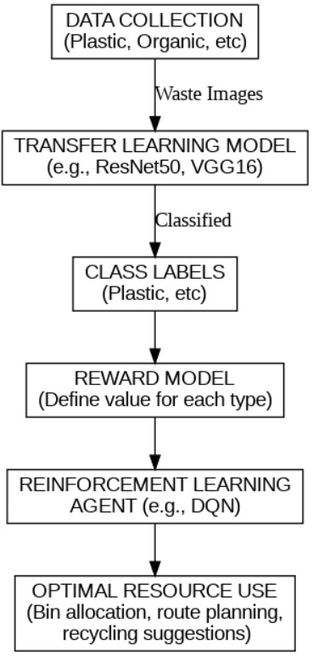
Proposed Flowchart/ Methodology
Data Collection Waste images are gathered from smart bins or public disposal points and categorized into types such as plastic, organic, paper, metal, and glass.
Transfer Learning Model Pre-trained deep learning models like ResNet50 or VGG16 are fine-tuned to classify waste images with high accuracy, reducing the need for large training datasets.
Class Label Assignment Each image is tagged with its predicted waste type, forming the basis for downstream decision-making and resource planning.
Reward Model Definition A reward value is assigned to each waste type based on its recyclability, environmental impact, or economic value—guiding the learning process of the RL agent.
Reinforcement Learning Agent An RL agent (e.g., DQN) learns optimal actions such as bin allocation, route planning, and recycling prioritization by interacting with the environment and maximizing cumulative rewards.
Optimal Resource Utilization The final output includes intelligent suggestions for waste segregation, collection routes, and recycling strategies—ensuring efficient and sustainable resource use.
Figure 2.
BATCH NO: 16 : DEPARTMENT OF COMPUTER SCIENCE & ENGINEERING

Slide 9
Output
Expected Results:
We expect to demonstrate accurate classification of waste types using a transfer learning model (ResNet50), achieving high precision even in noisy or real-world conditions. The system will also showcase intelligent decision-making through reinforcement learning, enabling optimized bin allocation, route planning, and resource prioritization.
Deliverables :
A fully functional AI-powered waste management system integrating both Transfer Learning and Reinforcement Learning modules.
A real-time dashboard for monitoring classification results, forecasting waste volume, and visualizing sustainability metrics.
A user-friendly web interface for uploading waste images and viewing system decisions.
Comprehensive project documentation covering system architecture, methodology, evaluation metrics, and performance results.
.
BATCH NO: 16 : DEPARTMENT OF ARTIFICIAL INTELLIGENCE AND DATA SCIENCE

Slide 10
Challenges and Mitigation Strategies
Potential Challenges:
Inconsistent image quality and lighting conditions affecting waste classification accuracy.
Limited availability of labeled datasets for diverse waste categories.
Balancing model complexity with real-time responsiveness in RL-based decision-making.
Ensuring reliable performance in offline environments without cloud support
Integrating dashboard visualization with backend AI modules for seamless monitoring
Mitigation Strategies:
Apply image preprocessing techniques (e.g., normalization, augmentation) to improve input consistency.
Use transfer learning with pre-trained models like ResNet50 to reduce data dependency.
Optimize RL agent architecture for faster convergence and low-latency inference.
Design lightweight, locally deployable models to ensure offline functionality
Build modular APIs and real-time data pipelines to connect AI outputs with dashboard components
BATCH NO: 16 : DEPARTMENT OF ARTIFICIAL INTELLIGENCE AND DATA SCIENCE

Slide 11
Conclusion
Summary:
Our project addresses the critical challenge of urban waste management by developing an AI-powered system that combines Transfer Learning for accurate waste classification and Reinforcement Learning for intelligent resource optimization.
This integrated approach enables the system to identify waste types with high precision and make data-driven decisions for bin allocation, route planning, and recycling prioritization. The results demonstrate improved operational efficiency, reduced landfill dependency, and enhanced sustainability—ultimately contributing to cleaner cities and smarter environmental practices.
BATCH NO: 16 : DEPARTMENT OF ARTIFICIAL INTELLIGENCE AND DATA SCIENCE

Slide 12
Ahmed, S., & Das, P. (2023). Optimizing municipal waste collection using multi-agent reinforcement learning. IEEE Transactions on Sustainable Computing, 8(1), 56–67.
REFERENCES
APA/ HARVARD STYLE
Zhang, Y., Wang, L., & Chen, H. (2023). Transfer learning-based waste classification using deep convolutional neural networks. Journal of Environmental Informatics, 45(2), 123–135.
Kumar, R., & Singh, A. (2023). Reinforcement learning for smart waste routing in urban environments: A deep Q-learning approach. Sustainable Cities and Society, 89, 104312.
Li, J., Zhao, M., & Tan, Y. (2022). A comparative study of CNN architectures for solid waste image classification. Waste Management, 138, 45–54.
Ahmed, S., & Das, P. (2023). Optimizing municipal waste collection using multi-agent reinforcement learning. IEEE Transactions on Sustainable Computing, 8(1), 56–67.
Chen, X., & Wu, Q. (2023). Real-time waste classification using transfer learning and edge computing. Sensors, 23(4), 1987.
Patel, N., & Mehta, K. (2022). Deep learning for waste segregation: A review of models, datasets, and deployment challenges. Environmental Modelling & Software, 157, 105512.
Singh, V., & Rajan, R. (2023). Integrating AI into smart waste management systems: A survey of techniques and applications. Artificial Intelligence in Environmental Engineering, 12(3), 78–94.
BATCH NO: 16 : DEPARTMENT OF ARTIFICIAL INTELLIGENCE AND DATA SCIENCE

Slide 13
THANK YOU!
BATCH NO: 16 : DEPARTMENT OF COMPUTER SCIENCE & ENGINEERING

